Slide 1
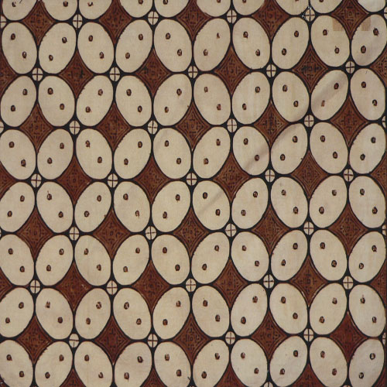
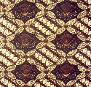
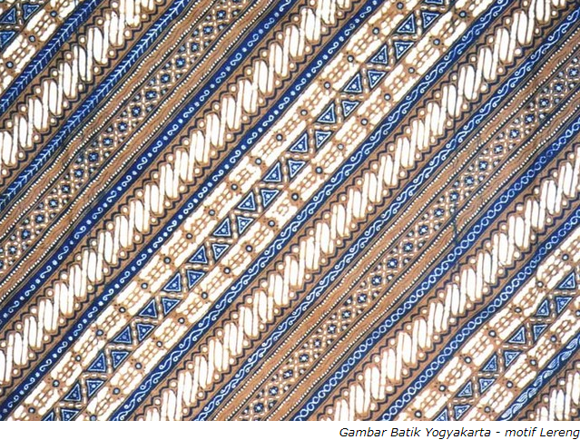
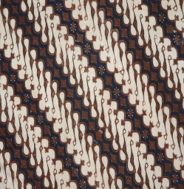
Capstone Design 2
Batik Pattern Recommendation Based on User’s Sketch
Ecstexela Syenne
2015105890

Slide 2
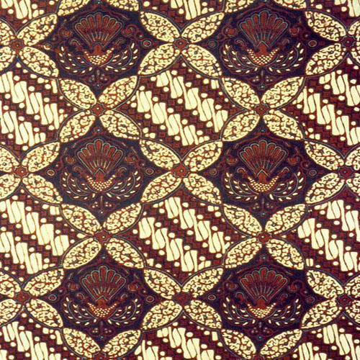
Research Purpose
BATIK
Indonesian Traditional Fabric Motif
How to generate an application that can recommend batik pattern based on simple sketch to help Batik designer?

Slide 3
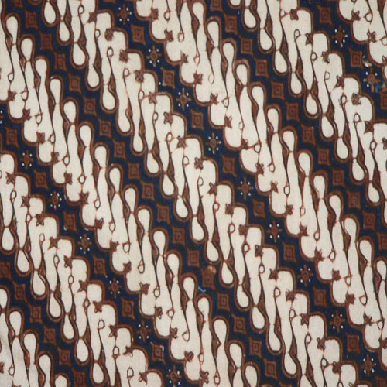
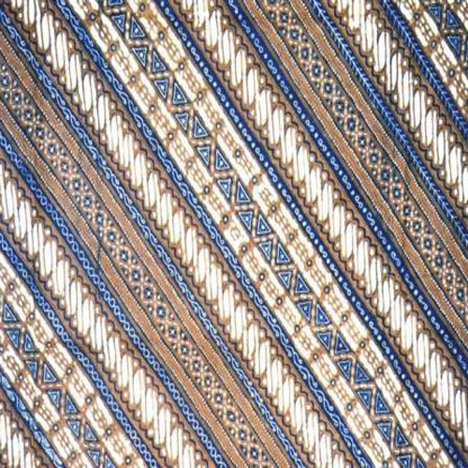

5 BATIK CLASSES
Batik
PARANG
Parang (traditional blade) motifs
Batik
LERENG
Blade-like pattern but less pointy than Parang
Batik
CEPLOK
Repetition of geometrical motif shapes (eg. Rectangle, square, oval, stars)
Batik
KAWUNG
Kawung fruits motif
Batik
NITIK
Flowers-like motifs
Batik
PARANG
PowerPoint is a computer program created by Microsoft Office

Slide 4
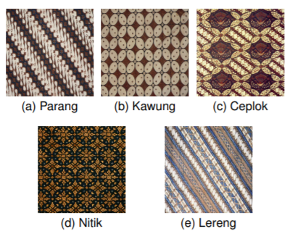
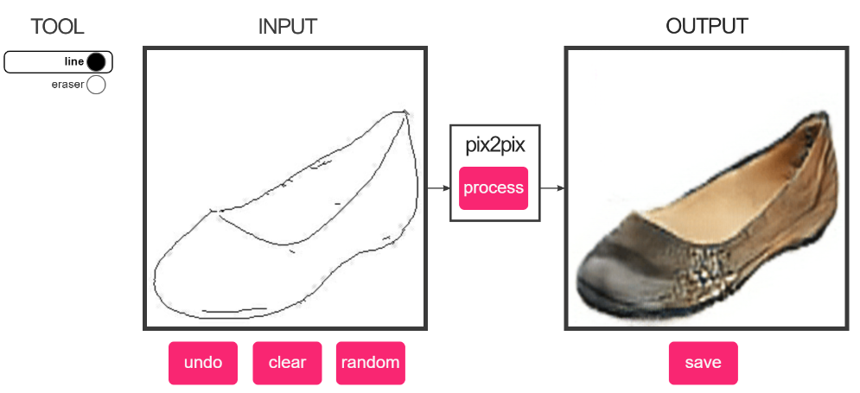
Related Works
PIX2PIX using CGAN
BATIK CLASSIFICATION USING TRANSFER LEARNING WITH VGG16 CNN

Slide 5
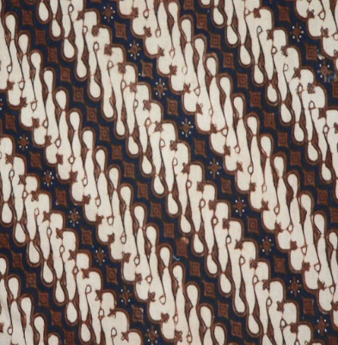
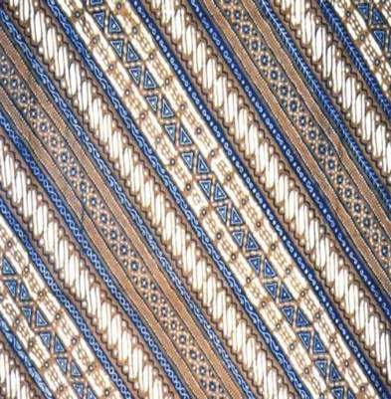
Problem of Related Works & Solution
Batik Classification
Clearly distinguished samples between classes
For example, Parang and Lereng motifs data often overlaps each other. This condition often confuses classifier during training and causes less accurate generalization.
Batik Parang
Batik Lereng
Homogeneous quality of data
Due to the various sources of data, the quality of the data are also various. Removing low quality data and preprocessing high quality ones may produce homogeneous data and improve classifier training process.

Slide 6
Project
Batik Classification using Deep Convolutional Network Transfer Learning
Pix2Pix
Input Sketch
Recommend Batik Pattern
Classify Batik Type
Check Result
Canny
Edge Detection

Slide 7

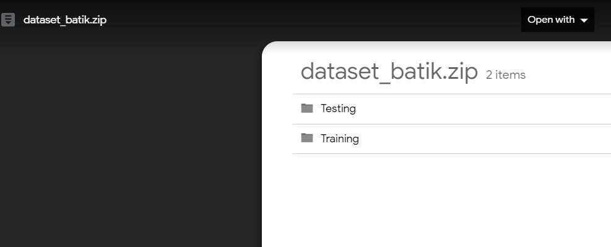
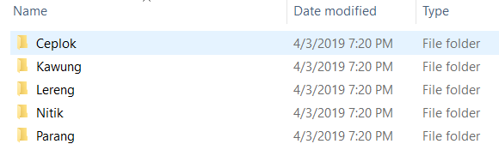
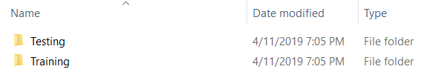
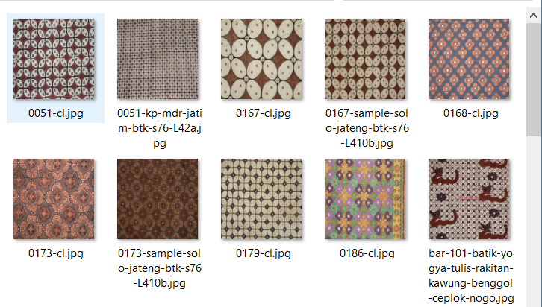
Project
Dataset
Source: https://drive.google.com/file/d/1uFnhO8WXdnyTBxGFy1qlqWU4iPmEF0kH/view

Slide 8
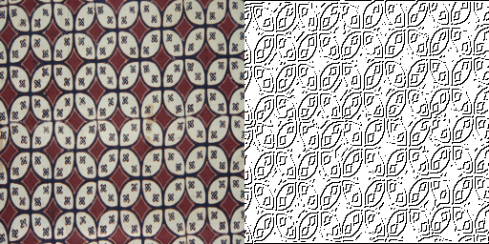
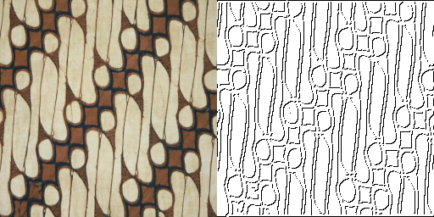
Project
Canny Edge Detection
Convert the existed data into edge
The existed image dataset is converted into edge by using Canny Edge Detection with 50 low threshold and 50 high threshold.

Slide 9
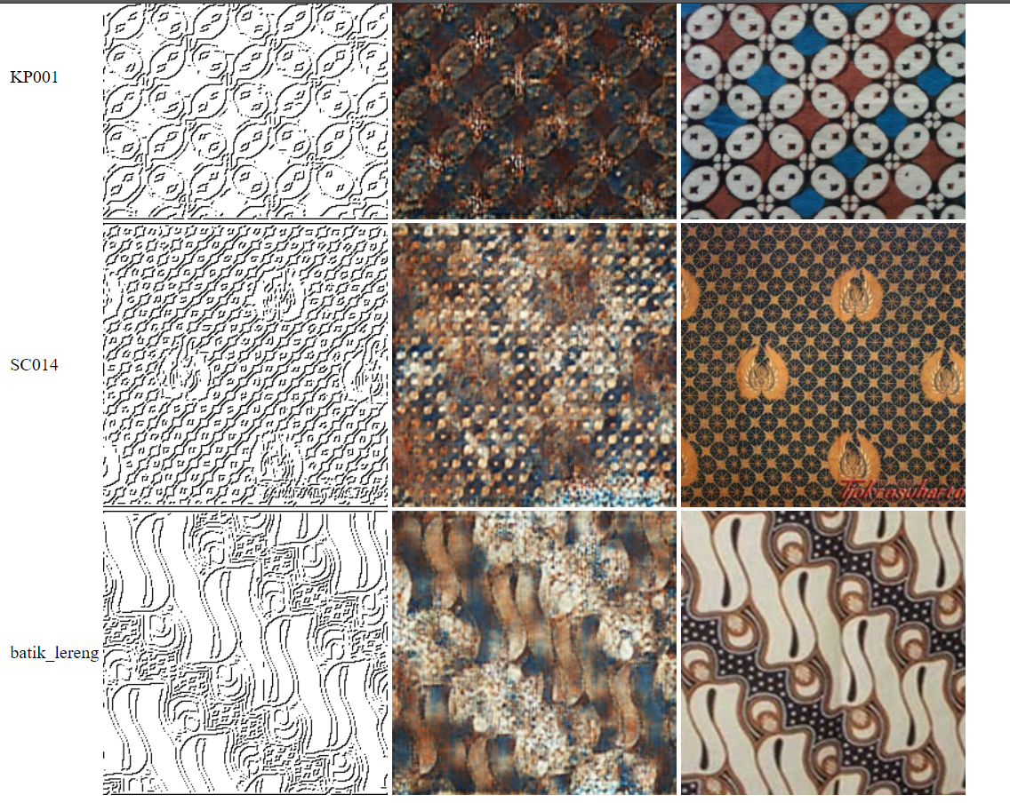
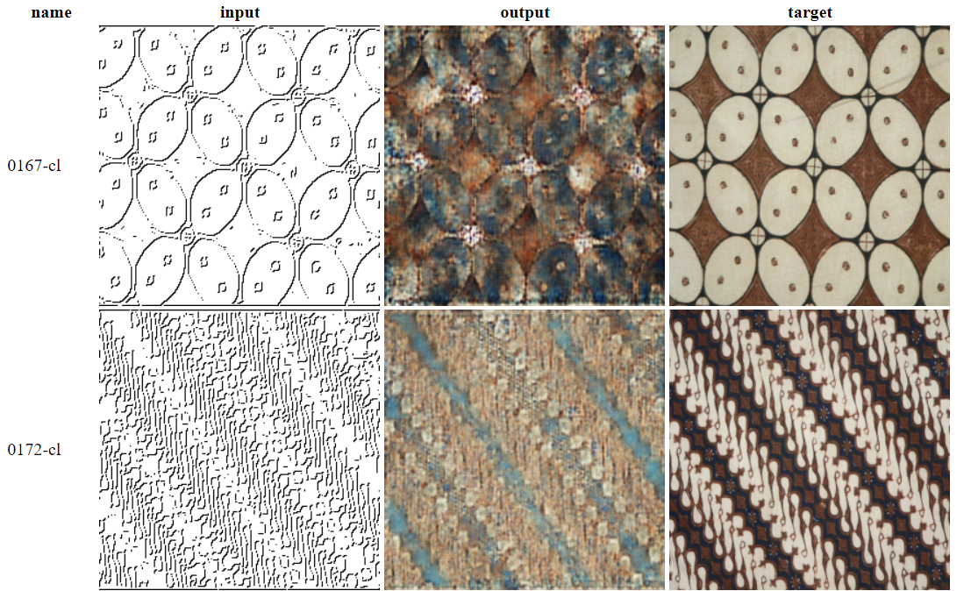
Project
After Training and Testing

Slide 10
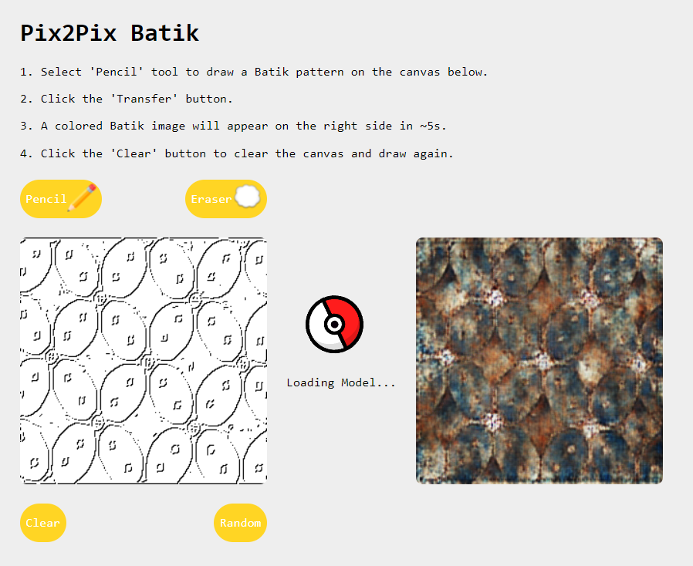
Project
Current Result
Demo: https://syenn2896.github.io/pix2pix-batik/

Slide 11
Timeline
03.18- …
03.29-04.01
04.23-04.24
06.16
Find Dataset
Write & Submit Topic Report
Write & Submit Mid Report
Submit Final Report & Demo
Check existing research data
Combine all codes and adding some codes
Editing codes
Complete all codes & make demo
03.15-03.21
03.19-03.28
04.02-04.23
04.24-05.30

